Slide 1
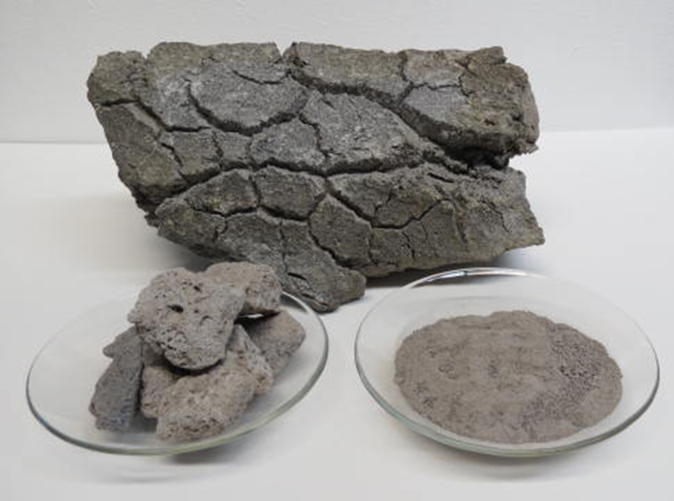
Volcanic Bomb
Pumice
Volcanic Ash

Slide 2
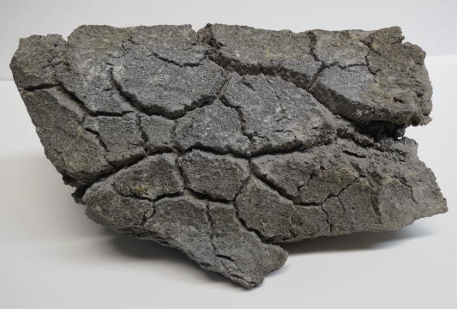
Volcanic Bomb

Slide 3
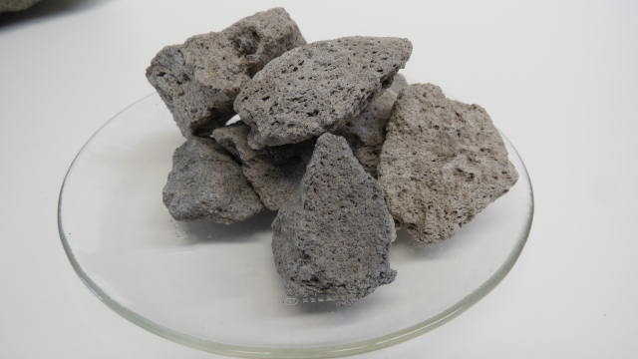
Pumice

Slide 4
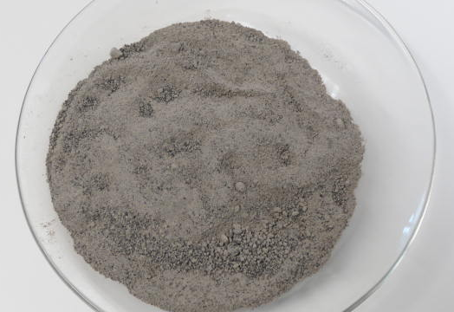
Volcanic Ash

